Slide 1
MONTHLY EXPENSE AND BUDGET ANALYZER
Team No: 5
Y. Lohith Kumar — 2620030125
S. Tanay — 2620030120
Annam Srivaibhav — 2620040151
Problem Solving Through Programming (Java)

Slide 2
Abstract
This Java console application helps users track monthly spending against a budget. Users enter a budget, then record expense names and amounts. The program adds expenses, calculates the remaining balance, and displays whether spending is within budget, exactly at the limit, or over budget. It supports up to 20 expenses.

Slide 3
Understanding Problem Statement
Problem: It can be difficult to keep track of small daily expenses and know how much money remains.
Input: Monthly budget; each expense name and amount; yes/no to continue.
Process: Add each expense to a running total, subtract the total from the budget, and compare the result with zero.
Output: Budget, total expenses, money left or overspending warning.

Slide 4
CO 1
Problem Solving & Java Basics
• Problem analysis: identify inputs, calculations, and outputs.
• Algorithm: read budget → collect expenses → sum amounts → calculate balance → display report.
• Scanner reads numeric and text input.
• Variables: double money, total, expense, balance; String item, answer.
• Arithmetic: total = total + expense; balance = money - total.

Slide 5
CO 2
Control Flow
• for loop repeats expense entry up to 20 times.
• if (i < 20) asks whether to continue.
• equalsIgnoreCase("no") checks the user response.
• break stops the loop when the user chooses no.
• if / else if / else classifies balance as positive, zero, or negative.

Slide 6
CO 3
Methods & Arrays
• This version performs calculations inside main().
• No user-defined methods or arrays are implemented in the supplied money.java.
• Possible extension: calculateBalance(budget, total) method.
• Possible extension: arrays to store expense names and amounts for item-wise reporting.
• These are proposed improvements, not existing features.

Slide 7
CO 4
Object-Oriented Programming
• The supplied program uses the money class with a main() method.
• Scanner is instantiated as an object to read keyboard input.
• The current version does not define custom constructors or expense objects.
• Future enhancement: Expense class with item name and amount; constructor to initialize values.

Slide 8
CO 5
Strings
• String item stores what the user spent money on.
• String answer stores yes/no input.
• nextLine() reads the text.
• equalsIgnoreCase("no") accepts NO, No, or no.
• This makes the stop command case-insensitive.

Slide 9
CO 6
Program Reliability & Future Scope
• Current code closes the Scanner after reporting.
• Current code does not use try-catch exception handling.
• Proposed: reject negative budgets and expense amounts.
• Proposed: handle invalid numeric input with try-catch.
• Proposed: save expenses to a file/database and add category summaries.

Slide 10
Conclusion
The Monthly Expense and Budget Analyzer demonstrates Java input handling, variables, arithmetic, loops, conditional statements, and strings in a practical personal-finance task. It calculates total spending and tells users whether they are within budget or have exceeded it. Future versions can save records and produce more detailed reports.

Slide 11
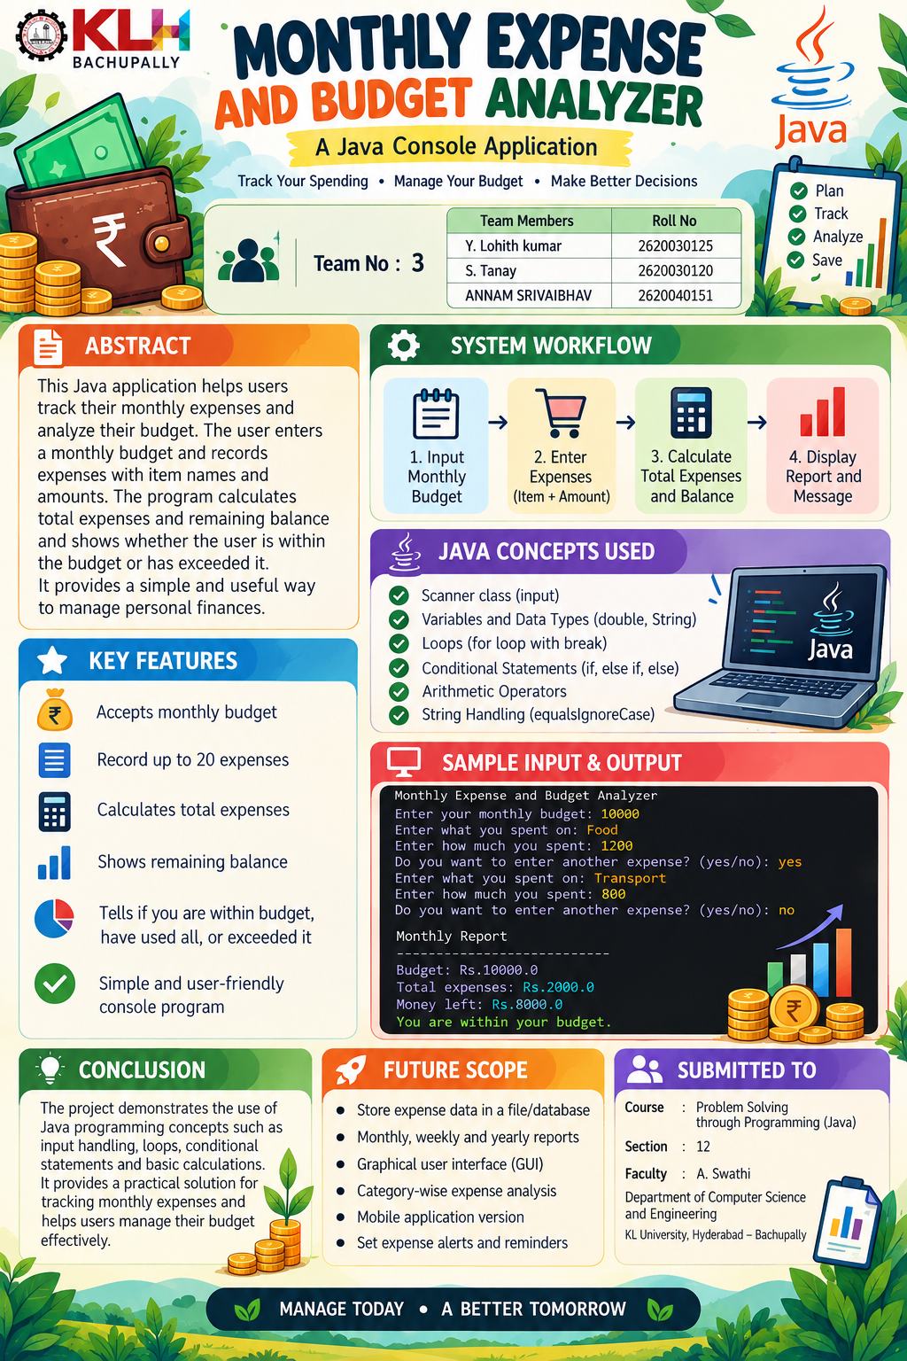
Screen Shots

Slide 12

Geo Tag Photo and git hub link
GitHub Repository: Add your verified link before submission

